Slide 1







中国国际贸易单一窗口
联通世界，让贸易更畅通
China International Trade Single Window
Let Trade Simple
Single Window in China: Practice and Progress
National Office of Port Administration, GACC
Notes:
更多精彩模板请关注【沐沐槿PPT】https://mumjin.taobao.com/
1
1
1

Slide 2
Contents
1
Background
6
Service coverage
2
Stages
7
Performance
3
Layout & ICT
8
Achievements
4
Governance structure
9
Future steps
5
Business model
10
Lessons learned
Notes:
2
2
2

Slide 3


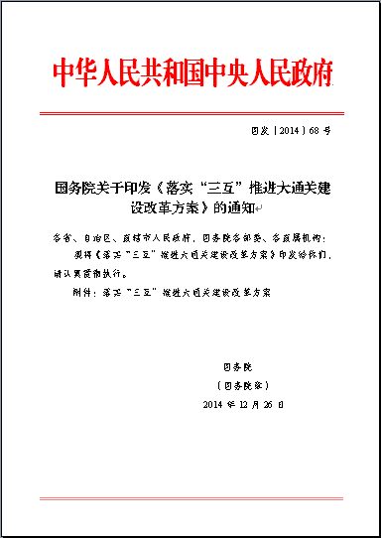
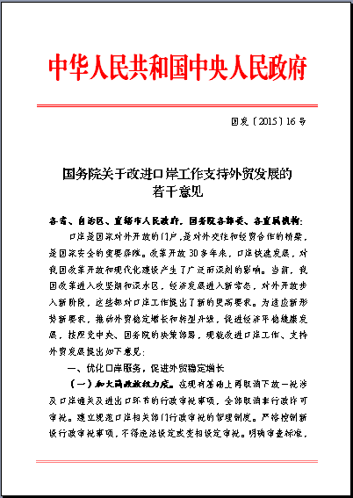

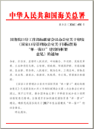

1. Background
the SW is highly valued by Chinese Government
1970s
Customs automation system.
Time line
1988
H883 - decentralized customs service system.
2001
The birth of China E-port, with other CBRAs (cross-border regulatory agencies).
In recent years, a series of important documents in the field of economic development issued by the State Council emphasize the construction of Single Window based on e-port and the promotion of trade facilitation.
Single Window as a must was written into the central government work report consecutively for three years (2016, 2017, 2018).
2016
The initiation of National Single Window(NSW) based on China E-port.
2018
NSW as the one-stop Trade Service Platform is proposed
Notes:
2
2
3

Slide 4
2. Stages
Four stages of development
SW connectivity
(N2N)
Fast, seamless and safe inter-connection with trading partners and be an important facility for foreign trade.
Trade services (B2B)
Interfaced with relevant industries with cross-border trade big data analysis to build a one-stop platform for trade services.
Port regulation
(B2G)
Integrating CBRAs’ business systems at the central level and providing one-stop services for formalities and procedures.
Top design
2016, The Framework Opinion on NSW was approved and then issued nationwide.
Notes:
2
2
4

Slide 5






3. Layout & ICT integration
The layout includes both central and local levels
GACC
MPS
MOT
STA
SAFE
Others
China International Trade Single Window
Unified operation and maintenance
Unified C/A
中国国际贸易单一窗口
Big data services
Countries
Inter-agency information sharing and networking application
Port law enforcement and basic services
Cross-border information exchange
Regions
Unified Standards
Cargo
Manifest
Means of transport
Trade permits
Enterprise qualification
Financial insurance service
Customs clearance assessment
E-payment
Tax rebate
Statistics & inquiry
Cross-border
e-commerce
Processing trade and bonded services
Intelligent cargo tracking
Portrait for users
Organizations
China E-port
Third-party platform 1
China (XX) International Trade SW
China (XX) International Trade SW
……
Unified Portal
Local e-port n
Third-party platform 2
Local e-port 1
Local e-port 2
Services
Services
Services
Services
Services
Services
…… n
All dealers and participants (port management, foreign trade, warehousing, logistics, financial services, etc.)
Notes:
2
2
5

Slide 6
4. Governance structure
Responsibilities of central and local levels respectively
The central gov.
  The Inter-ministerial Joint Conference on Port Administration (IJCPA) is responsible for the overall planning of China SW.
  The National Office of Port Administration (NOPA) of GACC takes the lead to promote the implementation of SW.
  The Working Group for the Establishment of National Single Window (NSW Group) consisting of Cross-Border Regulatory Agencies (CBRAs) acts as the decision-making and steering entity.
  China E-port Data Center is the technical implementer of China NSW.
The local gov.
  The provincial governments take the lead to organize the local leading group, being responsible for applying and promoting the NSW, and also actively expanding local special services.
Notes:
2
2
6

Slide 7
5. Business model
Free of charge and standards unification nationwide
Data elements unified
Operation unified
Web
portal unified
7
Uni-s
Info security unified
User CA
unified
Data management unified
Interface unified
Notes:
2
2
7

Slide 8




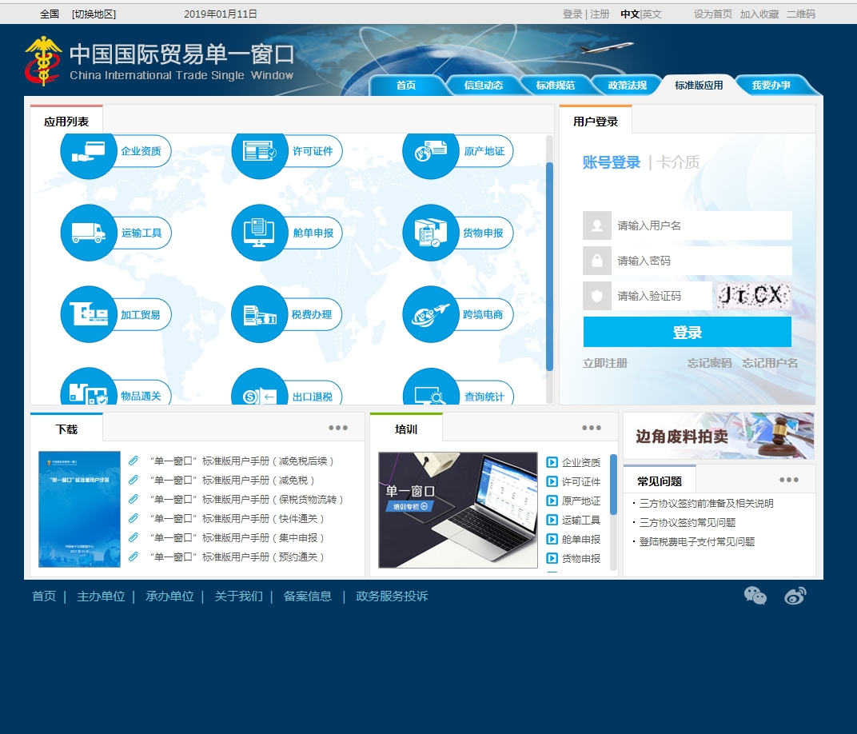




















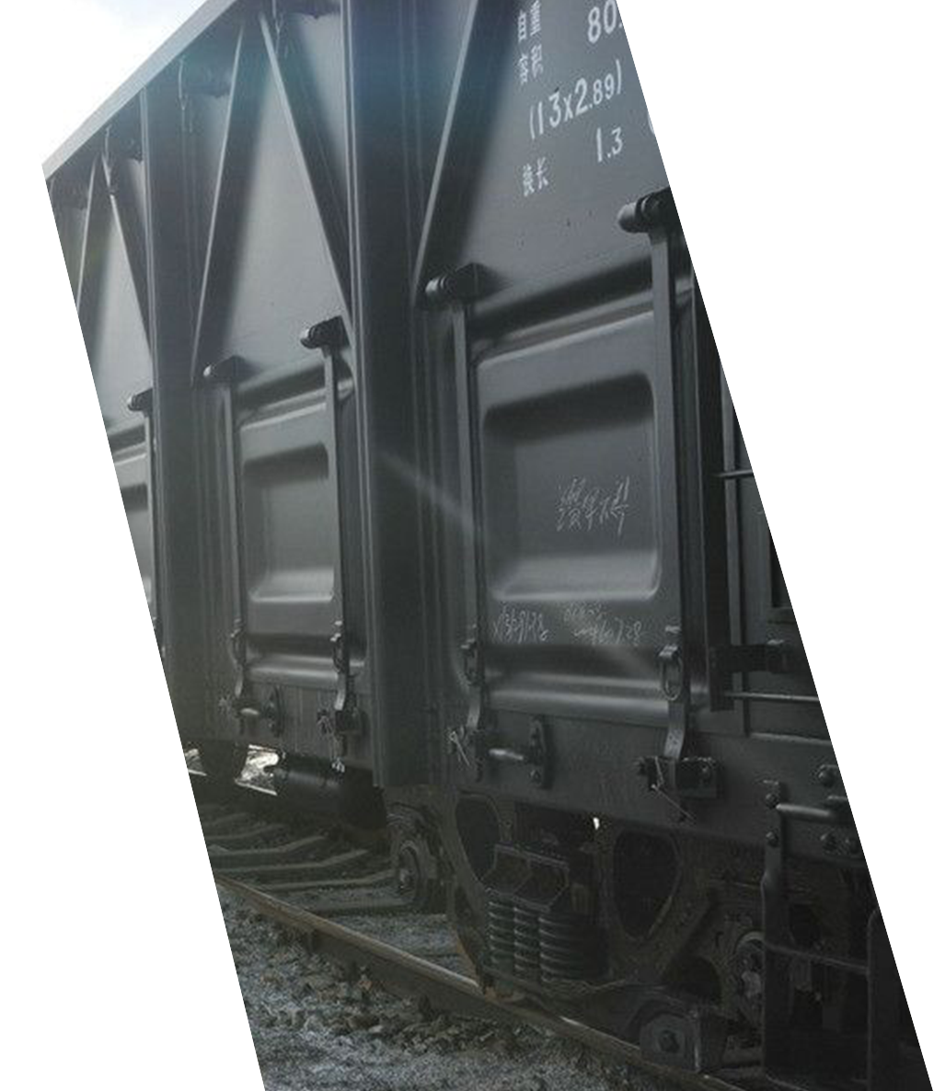
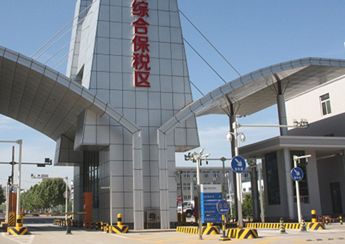




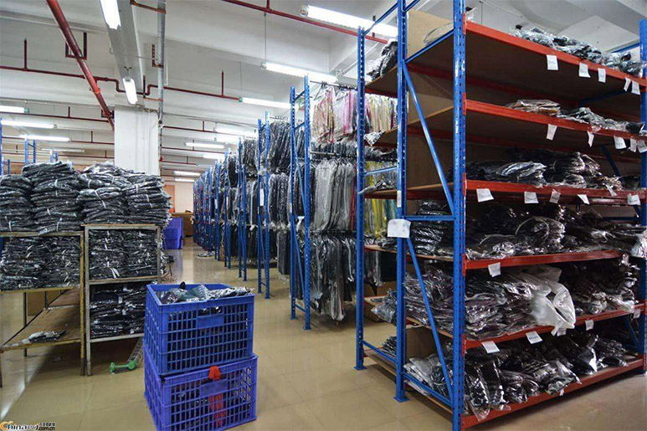
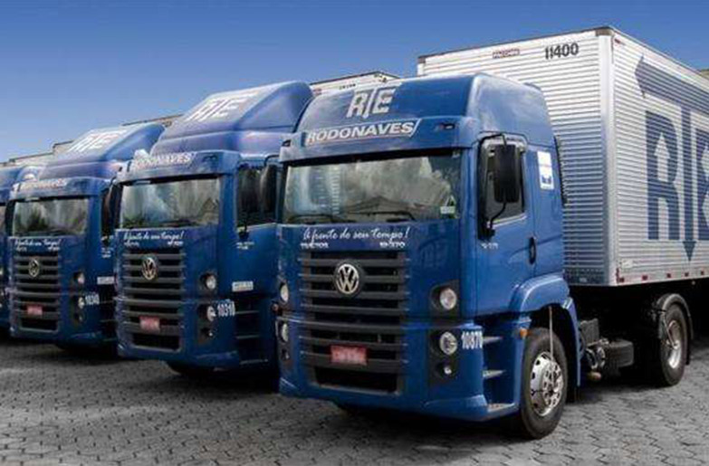


6. Service coverage
16+ categories of basic service functions
提供对外服务事项495项
600+ service items
25+ CBRAs
Cargo dec
Manifest
Means of transport
Trade licenses
c/o
Qualification
Inquiry & statistics
Export tax rebate
…
…
Tax payment
processing & bonded business
Financial services
Cross-border e-commerce
Water port
Air port
Road port
Railway port
Bond areas
Production
Trade
Warehousing
Logistics
E-commerce
Finance
Notes:
2
2
8

Slide 9
7. Performance
Key indicators (as of Sept. 2019)
Daily volume of declarations
8 million+
Coverage of core applications
to be 100%
Core system availability
99.9%+
Number of registered users
2.7 million+
Paperless rate of customs clearance
98%+
Compression rate of customs clearance time
50%+
Cut enterprises’ customs clearance costs
1/3
Charge for using SW
zero
Notes:
2
2
9

Slide 10




8. Achievements
Benefits and praises received
The World Bank’s Doing Business 2019 shows a jump of 32 places for China’s cross-border trade ranking……
Reduced documents
Better process
The Session of WTO’s Seventh Trade Policy Review on China on 13 July 2018……
Higher efficiency
The American Chamber of Commerce in Shanghai’s 2018 Trade Environment Satisfaction Survey Report ……
Lower cost
Notes:
2
2
10

Slide 11
8. Achievements
Case1: Online handling regulatory documents (or LPCO)
Streamline LPCO
e-LPCO verification
Cross-border connection
  The number of LPCO droped from 86 to 48, with a decrease of 1/3, and time reduced 50%+
  100% of LPCO with online registration, application, transmission and feedback.
  Network-verification of inspection and quarantine certificates with more countries.
Previous
Now
25+ Stakeholders
80+ LPCO
On-site handling
Multi-system operation
One platform
Real-time status info pushing
Data sharing, network verification and collaboration
Clearance information sharing
Notes:
2
2
11

Slide 12
8. Achievements
Case2: business process optimization and paperless
——Taking the means of transportation as an example (ship)
For the entry or exit of the means of transportation, the carrier or its agent shall report to authorities the dynamic forecast, confirmation, number of passengers, quantity of goods of the means of transport, all with dynamic information.
2 Days
<2 Hours
Prevous
Nowadays
Multiple system
1113 data elements
44 categories, 70+ kinds, 150+ pages paper application materials
Back and forth, 9+ times
Series procedures
One system, once log in
371data elements
All paper materials are cancelled except for the crews’ passport
At most 1 time offline procedure (crew passports)
Parallel procedures
Notes:
2
2
12

Slide 13



9. Future steps
Three more-s
1. More convenient
3. More internationalized
2. More intelligent
Notes:
2
2
13

Slide 14
10. Lessons learned
Five key conclusions can be drawn
1
Strengthening the leadership is the key factor for a successful implementation of the SW.
2
Responding to users’ needs is the vitality of the SW.
3
Scientific and rational top-level design surely exert the benefits of the SW.
4
Stakeholders’ collaboration support the effective implementation of the SW.
5
Innovative technological applications help create a more convenient SW for traders.
Notes:
2
2
14

Slide 15
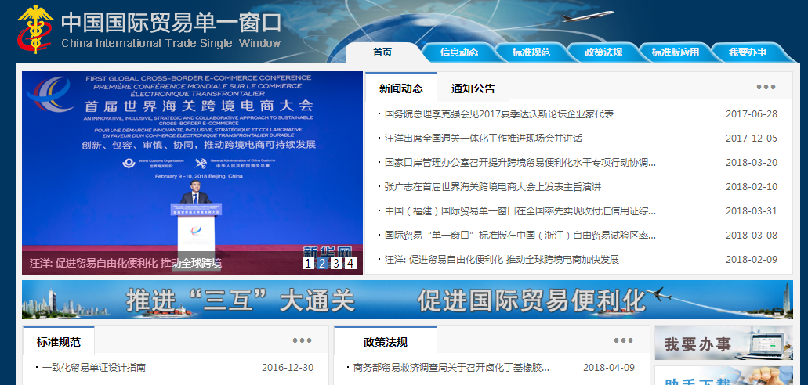
http://www.singlewindow.cn

Slide 16

Thank You
National Office of Port Administration
October, 2019
Notes:
2
2
16

